Slide 1
USAS 2024 Calendar Year End

Slide 2
2024 Calendar Year End Agenda
1099 Facts and Due Dates
1099-NEC & 1099-MISC Procedures
Pre-Closing Procedures
Calendar Year End Close

Slide 3
Due Dates of Forms & Instructions
Please have 1099 File sent to ACCESS no later than
January 10, 2025
ACCESS will file all forms by January 31, 2025
In order to do so, all files must be submitted to us by the January 10th deadline

Slide 4
Due Dates of Forms & Instructions
Filing of 1099 – NEC
A copy of Form 1099-NEC should also be sent to your vendors and independent contractors by January 31, 2025.
Filing of 1099-MISC
A copy of Form 1099-MISC should be sent to the MISC recipients by January 31, 2025.
General Instructions for Certain Information Returns
https://www.irs.gov/instructions/i1099gi

Slide 5
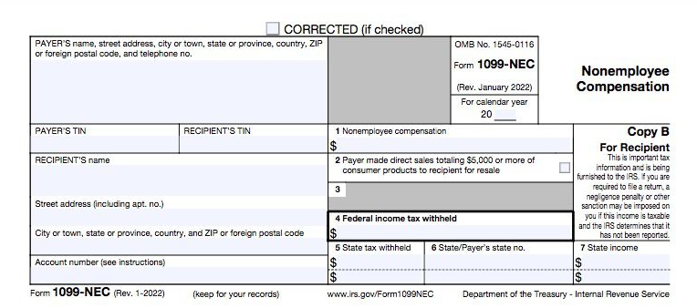
1099-NEC
Non Employee Compensation
Box 1 - Amount of
nonemployee
compensation.
Box 4 - Amount to
comply with backup
withholding
requirements.
Boxes 5-7 - Amount of any state withholding.

Slide 6
1099-NEC
Non Employee Compensation
Form 1099-NEC
Payments of $600 or more for services of nonemployees and attorneys
Non-Employee Compensation is Reported in Box 1
There is no automatic extension available for the 1099-NEC form.
A request for an extension can be submitted by paper Form 8809, refer to Part A, Sec. 8, Extensions
Prior Year Corrections
Corrections from prior years should be reported on prior year forms

Slide 7
1099-NEC
File Form 1099-NEC, Nonemployee Compensation, for each person in the course of your business to whom you have paid the following during the year.
At least $600
Services performed by someone who is not your employee (including parts and materials) (box1)
Cash payments for fish (or other aquatic life) you purchase from anyone engaged in the trade or business of catching fish (box 1)
Payments to an attorney (box 1)
You must also file Form 1099-NEC for each person from whom you have withheld any federal income tax (report in box 4) under the backup withholding rules regardless of the amount of the payment.

Slide 8
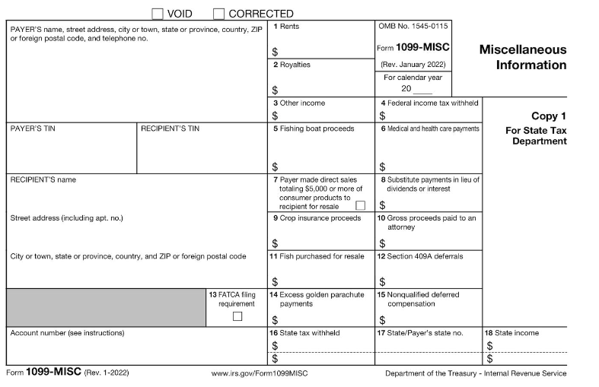
1099-MISC Information
Payer made direct sales of $5,000 or more (checkbox) in box 7
Crop insurance proceeds– Box 9
Gross proceeds to an attorney – Box 10
Section 409A deferrals-Box 12
Nonqualified deferred compensation income is reported in box 14
Boxes 15, 16, and 17 report state taxes withheld, state identification number, and amount of income earned in the state, respectively.

Slide 9
1099-MISC
File Form 1099-MISC, Miscellaneous Information, for each person in the course of your business to whom you have paid the following during the year.
At least $10 in royalties (see the instructions for box 2) or broker payments in lieu of dividends or tax-exempt interest (see the instructions for box 8).
At least $600 in:
Rents (box 1);
Prizes and awards (box 3);
Other income payments (box 3);
Generally, the cash paid from a notional principal contract to an individual, partnership, or estate (box 3);
Any fishing boat proceeds (box 5);
Medical and health care payments (box 6);
Crop insurance proceeds (box 9);
Gross proceeds paid to an attorney (box 10) (see Payments to attorneys, later);
Section 409A deferrals (box 12); or
Nonqualified deferred compensation (box 15).

Slide 10
Payments to Attorney
1099 NEC
Payments to attorneys. The term “attorney” includes a law firm or other provider of legal services. Attorneys’ fees for $600 or more paid in the course of your trade or business are reportable in box 1 of form 1099-NEC, under section 6041A(a)(1)
1099 MISC
Gross proceeds paid to attorneys
Under section 6045(f), report in box 10 payments that:
Are made to an attorney in the course of your trade or business in connection with legal services, but not for the attorney’s services, for example as in a settlement agreement;
Total $600 or more: and
Are not reportable by you in box 1 of Form 1099 NEC File Form 1099-NEC, Nonemployee Compensation, for each person in the course of your business to whom you have paid the following during the year.

Slide 11
CYE – Things that can be done now
Review & Verify Vendors
Vendors Tax ID Type (SSN or EIN)
Vendors ID #
Vendors Type 1099
Vendors 1099 Location (address)
Vendor Merge

Slide 12
CYE – Things that can be done now
1099 Vendor Information located under Core / Vendors
1099 section
Locations

Slide 13
Edit Vendor Details
Vendor Names/Addresses
Name/address on W-9 form may be different than name/address for checks

Slide 14
Merge Vendors
Merge Vendors Eligibility
When viewing a Vendor, qualifying vendors will have the Merged Vendor button available.
This button will only be available for vendors that are eligible to be merged or vendors that have already had other vendors merged into it.
A vendor is eligible to be merged if it is ACTIVE and there are other vendors that have the same Tax ID Type, Tax ID#, and Type 1099.
If there are no other vendors with this information it is not eligible
to be merged and therefore the Merged Vendors button will be
greyed out.

Slide 15
Merge Vendors
Merge Vendors
Click on Merged Vendors to open the Vendor Grid
Click on Merge Vendor to see the vendors eligible to merge

Slide 16
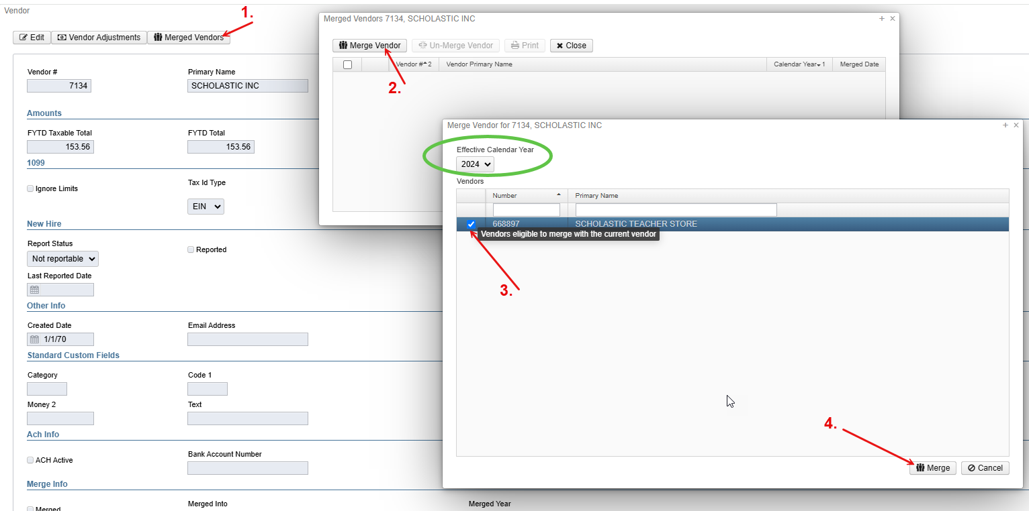
Merge Vendors

Slide 17
Merge Vendor
Updates to the New Vendor
Any transactions for the Calendar Year chosen in the Merge for the vendor(s) selected in the merge will be updated to be associated with the new vendor. Any amounts associated with updated disbursements will be included in the YTD Total(s) on the new vendor.
If you are completing these steps in 2025 make sure to choose 2024 from the dropdown

Slide 18
Options to Review 1099 Data
Vendor’s Grid
Core > Vendors
SSDT 1099 Vendor Report
Report Manager
1099 Extract Report
Periodic > 1099 Extracts > Print 1099 Report

Slide 19
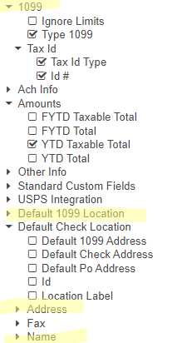
Vendors Grid-MORE Button
1099 Info
Type 1099
Tax ID Type
Id#
Default 1099 Location
Name
Address
Use the Report button to save your filtered grid settings

Slide 20
Vendors Grid – 1099 Vendors
Use the MORE button: Tax ID Type, ID#, & Type 1099
Use Filters:
Active: =true
Type 1099 : <> non 1099 (excludes non-1099 types)
YTD Taxable Total: >=600
Use the Type 1099 to filter on a specific 1099 type (i.e. Royalty Payments).
Use the YTD Taxable Total to filter on amounts
Use the Report button to print and/or save your filtered grid settings

Slide 21
Vendors Grid
View the Grid Details
non employee compensation*attorney gross proceeds*royalty payments*medical and healthcare*rents*other income
IRS Interactive TIN/Name Matching program
Optional
Can be used to check if SSN or EIN should be used by matching up the name and number combo on the IRS interactive site for immediate verification.
https://www.irs.gov/tax-professionals/taxpayer-identification-number-tin-matching

Slide 22
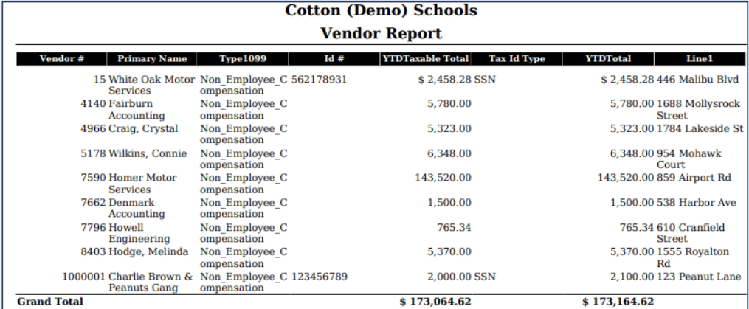
Vendors Grid – Report

Slide 23
Verify 1099 Data
Verify Vendors who should receive 1099s and their YTD amounts
Identify 1099 Vendors and non-1099 vendors
1099 Type
Vendors qualifying YTD Taxable Total

Slide 24
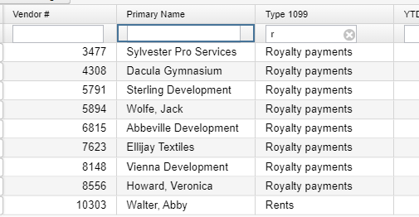
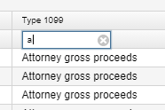
Review ‘Types’ using Vendors Grid
Use the Vendors Grid to filter Type 1099
Use the Report button to save and/or print your filtered grid settings

Slide 25
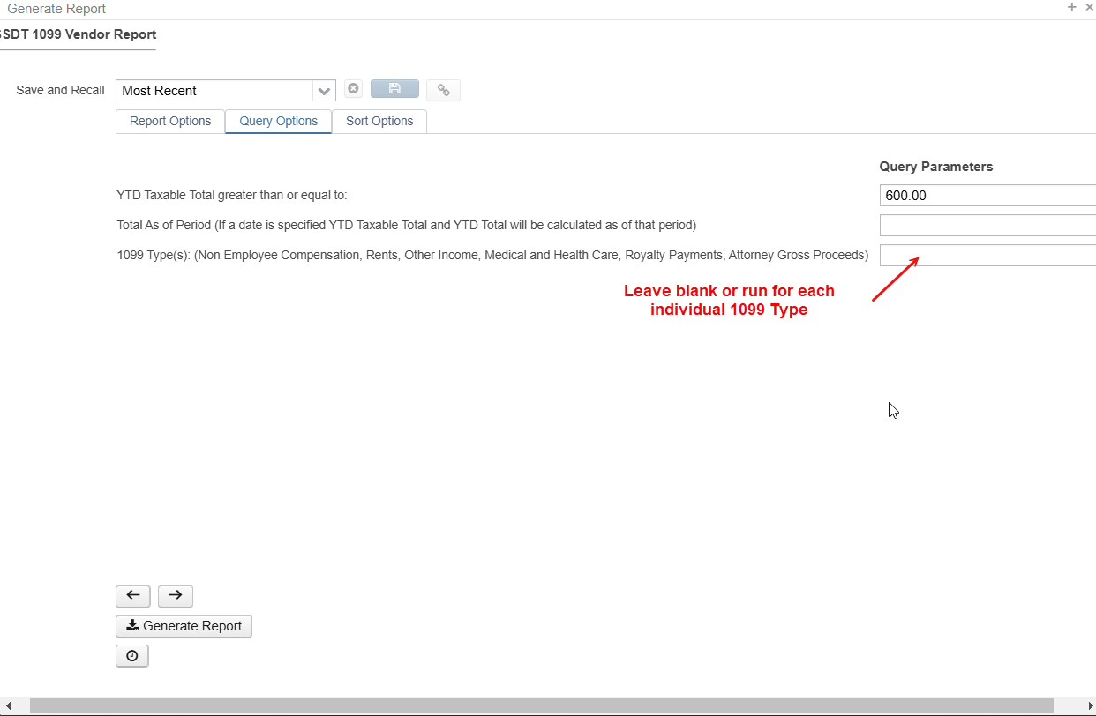
SSDT 1099 Vendor Report
Reports>Reports Manager>SSDT 1099 Vendor Report
Under Query Option enter the parameters you wish to run the report for

Slide 26
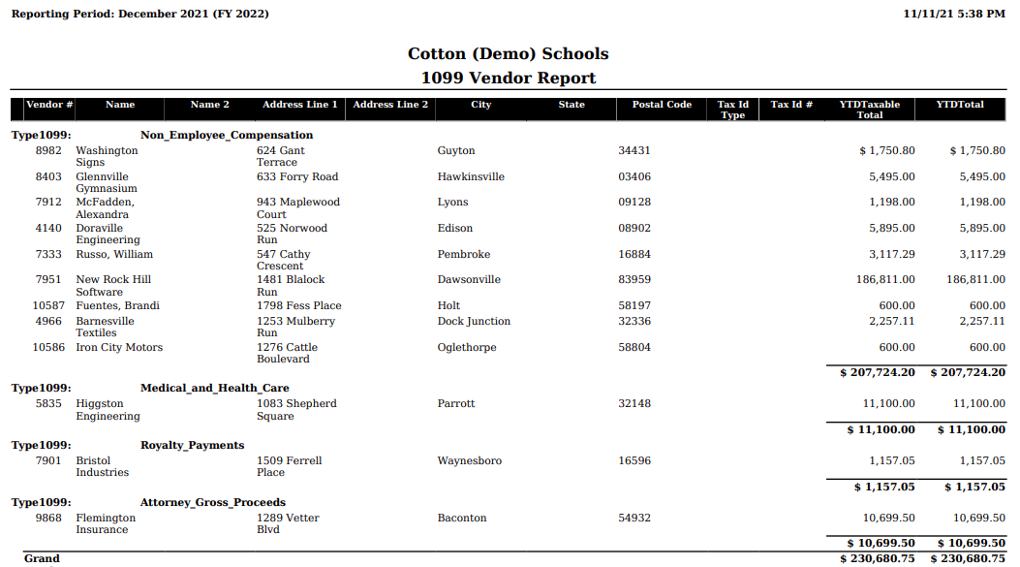
SSDT 1099 Vendor Report

Slide 27
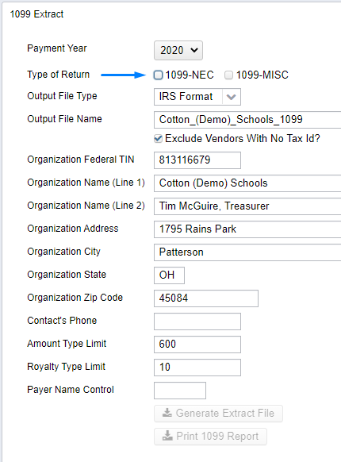
1099 Extracts Report
Periodic Menu > 1099 Extract > Print 1099 Report
Used to verify data prior to creating Extract File
Defaults to Exclude Vendors With No Tax Id
Must pick Type of Return before Print 1099 Report available
Subtotals by 1099 Type
NOTE: This report can NOT be run until the Posting Period for December has been created.

Slide 28
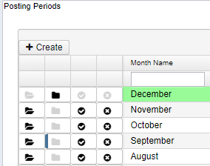
Review Posting Periods
Because the 1099 Extract report cannot be run unless December is created, now is a good time to review your open Posting Periods.
As months are closed, reports are created in File Archive.
Close July through November if you have not already done so.
Wait for the reports to complete before closing the next month.

Slide 29
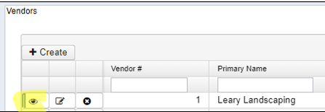
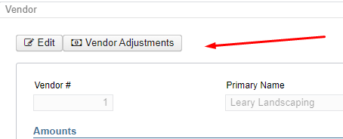
Vendor Adjustments
After reviewing if a manual adjustment is needed on the Vendor’s YTD Amount
View the Vendor under Core
Click on Vendor Adjustments

Slide 30
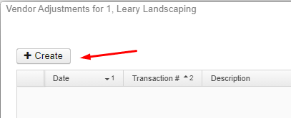
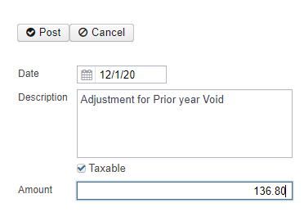
Vendor Adjustments
Create a new Adjustment
Enter Adjustment info
Amount can be positive or negative
Check Taxable box to update YTD Taxable Total

Slide 31
Month End Preparation
Proceed with balancing the month of December
Enter all transactions for the current month
Attempt to reconcile USAS records with your bank(s)
Perform Bank Reconciliation Procedure (link is provided in the CYE checklist)
Under Periodic menu, select ‘Cash Reconciliation’ to enter your cash reconciliation information for the month
Generate the SSDT Cash Summary report and the SSDT Financial Detail report
The detail report may be run for the month in order to compare MTD totals to the Cash Summary report for December. Totals should match.
If totals agree . . . You are balanced & may proceed, but do not yet close

Slide 32
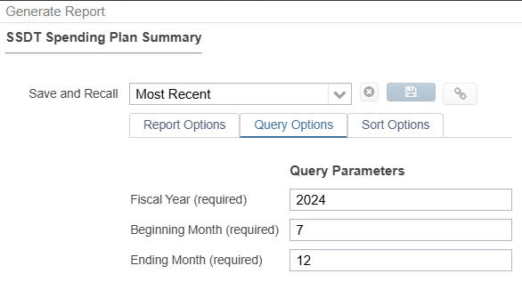
Month End Preparation
Optional - Run a Spending Plan Summary report
The Spending Plan Summary will generate a report in the same line number format as the Five-Year Forecast. It will list the current periods actual amount for each line number and will include a FYTD total
Under Query Options enter Fiscal Year and beginning and ending month numerically

Slide 33
Calendar Year End Preparation
Generate any desired Calendar Year End Reports (i.e. Workers Comp)
The Proration Utility program generates a spreadsheet which may be used to assist in calculating premium amounts for Worker's Compensation payments.
Utilities > Proration Utility
Choose Time Period – i.e. Calendar Year To Date
Choose Filter – i.e. Workers Comp ** Must be set up prior to running proration utility
(ex. Expenditure object 1%% in filter)
Enter File Name of your spreadsheet – i.e. Workers Comp 2021
Can run by Appropriation
Click Create to create spreadsheet
Enter amount to prorate in column B1
Download file to save in excel

Slide 34
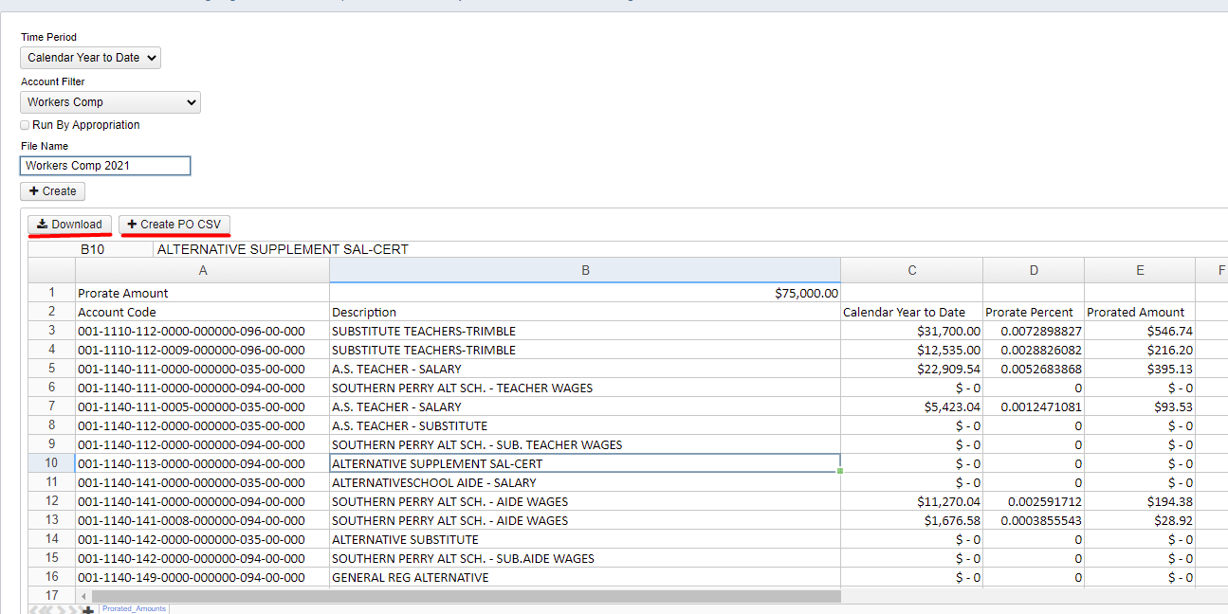
Example of Proration Utility

Slide 35
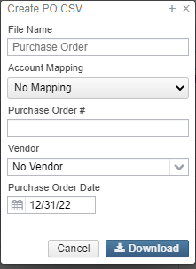
Example of Proration Utility
The Create PO CSV option can be used to download the information to a spreadsheet formatted with columns that can be use with the Purchase Order Import option. When generating the PO CSV, a window will pop up with the following options:
File Name: Name used for the CSV file that will be created.
Account Mapping: Used to map accounts in Proration Utility grid to different account codes if desired.
The Account Code Mappings should be pre-configured on the Account Code Mapping grid to appear in the drop down. (ex. Can be used to map salary account codes to benefit account codes)
Purchase Order #: A purchase order number can be assigned. If this field is left blank, a purchase order will be automatically assigned when the file is imported.
Vendor: Select a vendor to be used on the PO. If a vendor is not assigned to the imported record, the Purchase Order will be marked as a Multi-vendor PO.
Purchase Order Date: Used to assign the date used on the Purchase Order
This information is used to generate the PO CSV. However, any information can be manually edited on the spreadsheet prior to importing if needed.

Slide 36
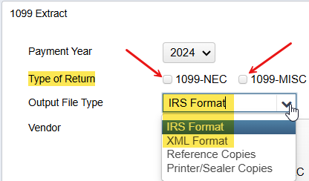
1099 Extracts
Once all 1099 data is verified, balanced and complete . . .
District runs the 1099 Extracts under the Periodic menu.
Output File Type: XML file
Used for printing 1099s with the Edge Software program
Output File Type: IRS format (TAP)
Used for IRS Submission
IMPORTANT!! Select both Types of Return prior to
running the extract.

Slide 37
1099 Extract Output
The IRS Format will create a file called:
Insert_District_Name_1099.tap
The XML Format will create a file called:
Insert_District_Name_1099.xml
Upload both to the
ACCESS Secure Transfer Site
https://secure.access-k12.org/login

Slide 38
Calendar Year End Closing
Core>Posting Periods – Close December
Month End Reports for December will automatically generate in the Utilities>File Archive> Monthly Reports Archive
Calendar Year End Reports will automatically generate in the
Utilities>File Archive>Calendar Year End Archive
Wait for the reports to complete.
District is now closed for the month & calendar year
Core>Posting Periods
Create new Posting Period for January

Slide 39
Monthly Reports Archive
Will automatically run when Posting Period is closed.
Wait until the bundle is complete before closing another month
Reports can be viewed under Utilities>File Archive
Individual reports cannot be deleted - only entire monthly bundle

Slide 40
Monthly Report Bundle
Cash Reconciliation Report for the month
Monthly Balance Report
Cash-related Reports: Cash Summary Report / Financial Detail Report for the month / Financial Summary by Fund
Budget-related Reports:
Budget Summary / Budget Account Activity Report (for the month)
Budget Transactions Summarized by Appropriation / Appropriation Summary Report
Negative Budget Report / Negative Appropriation Account Report / Error Corrections & Supplies Distributions
Revenue-related Reports: Revenue Summary / Revenue Account Activity report for the month
PO-related Reports: Purchase Order Detail Report for the month / Outstanding Purchase Order Detail Report /Transaction Ledger-Vendor Activity / Vendor Listing
Disbursement-related Reports: Detailed Check Register / Outstanding Disbursement Summary Report
Receipt-related Reports:
Receipt Ledger Report for the month / Reduction of Expenditure Ledger Report for the month
Refund Ledger Report for the month / Void Refund Ledger Report
Transfer Advance Summary / Fund to Fund Transfer Ledger Report
User Listing AOS Extract

Slide 41
Calendar Year End Report Archive
When 1099 Extract options are run, a copy will be sent to the File Archive > Calendar Year Reports Archive section.
Separate tab under Utilities > File Archive

Slide 42
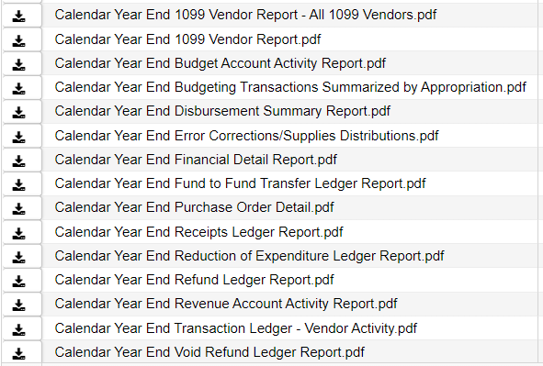
Calendar Year End Closing
When December is closed, reports will be generated:

Slide 43
Questions?

Slide 44
Have a wonderful holiday season

